Slide 1
SOC alert monitoring and log correlation
By Harikumar.E

Slide 2
Agenda
SOC and SIEM Overview
Log Collection and Alert Monitoring
Log Correlation Techniques
Incident Investigation Workflow
Impact Analysis and Recommendations
Conclusion

Slide 3
Abstract
This project demonstrates the process of monitoring security alerts and correlating logs using a SIEM platform in a simulated SOC environment. Logs from authentication, network, and endpoint sources are collected and analyzed to detect suspicious activities. Correlation rules are applied to identify potential security incidents, and a step-by-step investigation workflow is followed to triage alerts and assess their impact. The project highlights the importance of log correlation in reducing false positives and improving threat detection

Slide 4
Reconnaissance
Detected abnormal probing activity
Correlated web and firewall logs
Generated medium-severity alert
Early threat identification

Slide 5
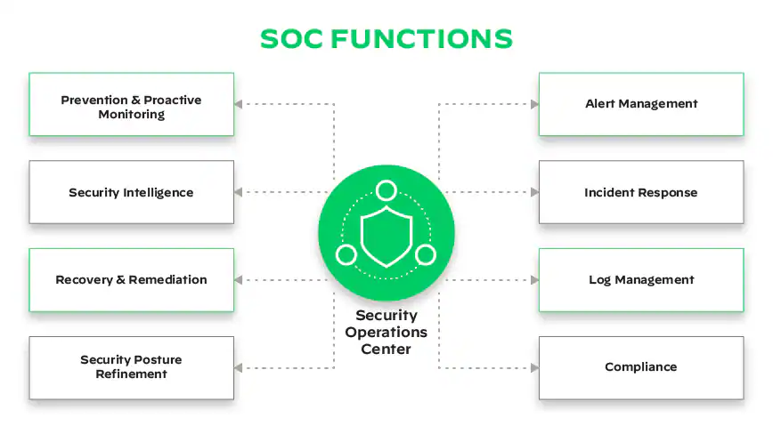
What is soc
  A Security Operations Center (SOC) is a centralized team or facility where cybersecurity professionals monitor, detect, investigate, and respond to security incidents in an organization 24/7.
What SOC Does
  Monitors security alerts from SIEM tools
Investigates suspicious activities and cyber attacks
Responds to incidents like malware, phishing, or intrusions
Improves security by tuning alerts and reducing false positives

Slide 6
SOC Alert Monitoring Log Correlation
SOC Alert Monitoring is the process of continuously observing, analyzing, and responding to security alerts generated by security tools like SIEM, firewalls, IDS/IPS, and endpoint protection systems.
SOC analysts review alerts to identify real security incidents, filter false positives, and take appropriate action to protect the organization.
Instead of looking at logs one by one, log correlation connects events together to understand the full attack story.

Slide 7

Popular SIEM Tools
Tool | Type | Usage / Key Feature
Splunk | SIEM / Log Analysis | Real-time monitoring, dashboards, alerts
ELK Stack | Open-source SIEM | Log collection, visualization, search
Wazuh | Open-source SIEM & HIDS | Endpoint security and alerting
Graylog | SIEM / Log Management | Centralized log management and dashboards
ArcSight | Enterprise SIEM | Advanced correlation and compliance reporting
IBM QRadar | Enterprise SIEM | Threat detection, incident analysis

Slide 8
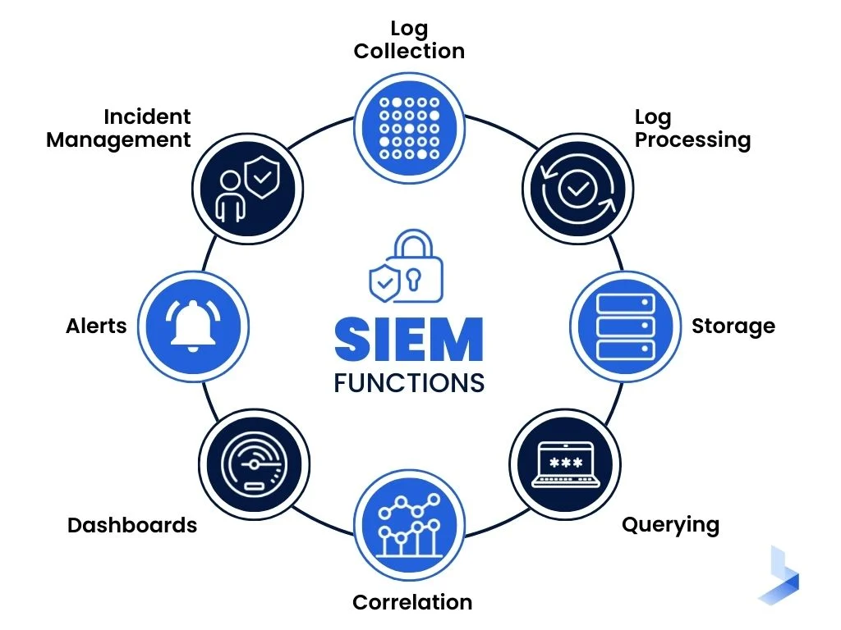
Log Correlation Using SIEM
What is SIEM (Security Information and Event Management)?
SIEM is a security platform that collects, analyzes, and correlates logs from multiple sources to detect and respond to cybersecurity threats.
How Alert Monitoring & Log Correlation Works
Log Collection: From servers, firewalls, endpoints
Normalization & Storage: SIEM stores logs in a common format
Alert Monitoring: Detect suspicious events using rules
Log Correlation: Combine related events across sources
Alert Generation: High, medium, low severity alerts
SOC Investigation: Analyze alerts, validate incidents
Response & Mitigation: Block IPs, disable accounts, escalate incidents

Slide 9
PROCESS
SIEM Setup
A SIEM tool (Splunk / ELK / Wazuh) is configured to collect logs from different systems and display alerts through dashboards.
Log Collection
Logs are collected from multiple sources such as authentication systems, network devices, and endpoints to ensure complete visibility.
Alert Monitoring
The SIEM continuously monitors incoming logs and generates alerts based on predefined security rules and thresholds.
Log Correlation
Related events from different log sources are correlated to identify suspicious patterns that indicate potential attacks.
Investigation & Response
SOC analysts analyze alerts, validate incidents, take corrective actions, and document findings.
Log Collection
Alert Monitoring
Log Correlation
Investigation
Response

Slide 10
ANALYSIS
Effectiveness of Alert Monitoring
Alert monitoring helps in early detection of suspicious activities and reduces response time
Impact of Log Correlation
Correlating multiple logs provides better attack visibility compared to analyzing single events.
Security & Business Impact
The project improves security posture, reduces risk of data breaches, and minimizes downtime.
Challenges Observed
High log volume and false positives require continuous tuning of correlation rules.
Improvements & Recommendations
Alert tuning, enhanced log sources, and automation can further improve SOC efficiency.

Slide 11
Blocking Malicious IP Addresses
  Add IPs to firewall or SIEM blocklists
Disabling Compromised User Accounts
  Lock or reset affected accounts
Isolating Affected Systems
  Disconnect infected endpoints from the network
Removing Malicious Files or Processes
  Delete malware, stop suspicious services
Applying Security Patches
  Fix vulnerabilities used in the attack
Updating SIEM Rules
  Improve correlation rules to prevent repeat attacks
Mitigation

Slide 12
conclusion
This project shows how log correlation works and improve threat detection , response. Centralized logging and correlation enable SOC analysts to identify attacks early and reduce security risks.

Slide 13
Thank You!

